Slide 1
Proiject-4
Feature Extraction and Price Prediction for Mobile Phones

Slide 2
Introduction
In this project, we will work with a dataset that contains detailed information about various mobile phones, including their model, color, memory, RAM, battery capacity, rear camera specifications, front camera specifications, presence of AI lens, mobile height, processor, and, most importantly, the price. Your primary goal is to develop a predictive model for mobile phone prices.

Slide 3
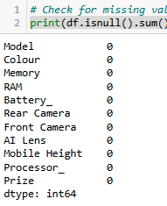
Step-by-Step Process
Data Exploration and Data Preprocessing:
Begin by loading and exploring the dataset to understand its structure, data types, and the range of values for each feature.
Eg: df = pd.read_csv('mobile_data.csv')
Handle any missing values, outliers, or inconsistencies in the dataset. Convert categorical variables (e.g., model, colour) into a suitable numerical format.
Eg: print(df.isnull().sum())

Slide 4
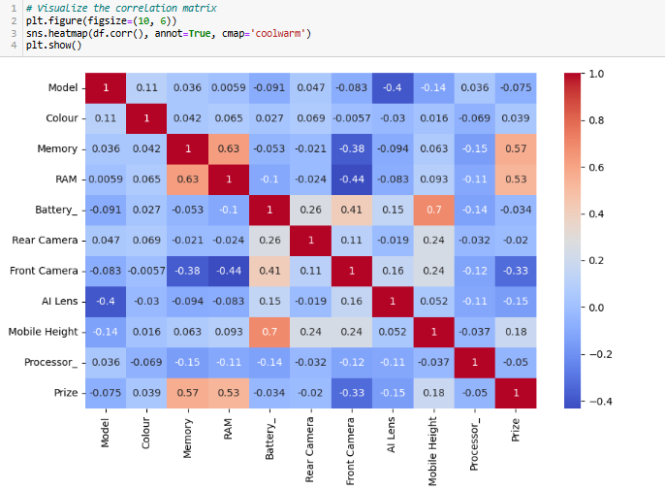
Feature Extraction:
Perform feature extraction to identify the most relevant features that strongly affect the price of mobile phones.
Use statistical methods, visualizations, or feature importance techniques (e.g., correlation analysis, feature selection, or dimensionality reduction) to narrow down the list of important features.

Slide 5
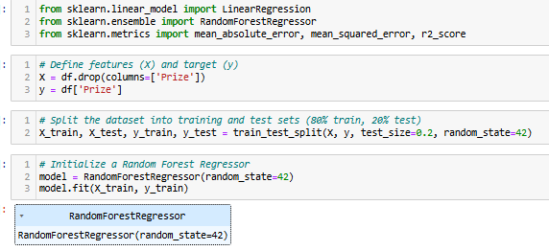
Model Building:
Split the dataset into training and testing sets.
Develop a machine learning model for price prediction. You can choose algorithms like linear regression, decision trees, or more advanced models like random forests or gradient boosting.

Slide 6
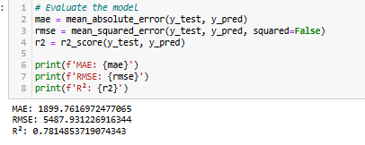
Model Evaluation:
Evaluate the model's performance using appropriate metrics (e.g., mean absolute error, root mean squared error) to assess how accurately it predicts mobile phone prices.

Slide 7
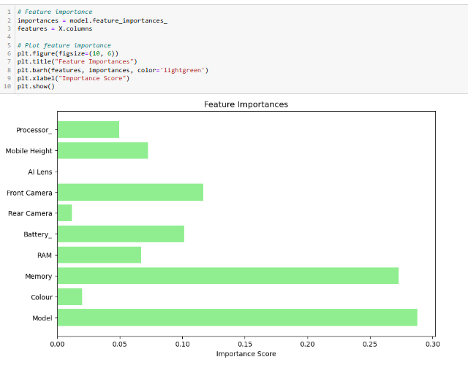
Feature Importance Analysis:
Analyze the feature importances obtained from your model to confirm the significance of the features identified during the feature extraction phase.
Report and Visualization:
Create a comprehensive report or presentation that summarizes the project's findings.
Include visualizations and insights related to feature importance and their impact on price prediction.
Recommendations:
Provide recommendations to the organization regarding which features have the most significant influence on mobile phone prices. This information can inform pricing strategies and marketing decisions.

Slide 8
Conclusion
This project successfully developed a predictive model to estimate mobile phone prices based on their features. Through feature extraction and analysis, key factors influencing price were identified, including processor type, RAM, memory, and camera specifications. The machine learning model provided accurate price predictions, and the feature importance analysis highlighted which attributes drive pricing decisions. These insights can help the organization optimize its pricing strategy and tailor marketing campaigns to focus on the most influential features, ultimately improving competitiveness in the mobile phone market.

